Slide 1


Software Faults And Failures
CHAPTER 2

Slide 2
Debugging
Software testing is a process that can be systematically planned and specified. Test design can be conducted, a strategy can be defined, and results can be evaluated against prescribed expectations.
Debugging occurs as a consequence of successful testing. When a test case uncovers an error, debugging is the process that results in the removal of the error.
Debugging is not testing, but it always occurs as a consequence of testing.

Slide 3
Debugging Process
The debugging process begins with the execution of a test case.
The debugging process attempts to match symptom with cause, thereby leading to error correction.
Two outcomes of the debugging:
1. The cause will be found, corrected, and removed
2. The cause will not be found.

Slide 4
Debugging Process
Execution of
Cases
Results
Test Cases
Additional Test
Suspected
Causes
Debugging
Regression Tests
Corrections
Identified Causes

Slide 5
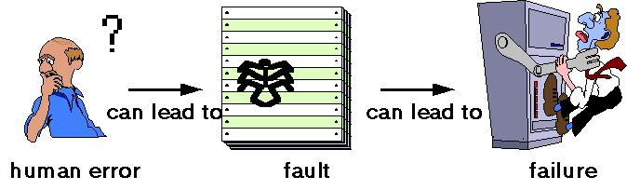
Faults & Failures
Software Testing is generally performed for one of two reasons –
→ To detect the existence of defects (faults).
→ To estimate the reliability of the code.

Slide 6
Faults & Failures
In software, an error is usually a programmer action or omission that results in a fault.
A fault is a software defect that causes a failure.
A failure is the unacceptable departure of a program operation from program requirements.

Slide 7
What is a Software Failure ?
According to Laprie et al.,
“ A System Failure occurs when the delivered service no longer complies with the specifications.”
“ An Error is defined as that part of the system which is liable to lead to subsequent failure, and an error affecting the service is an indication that a failure occurs or has occurred.”

Slide 8
Fault/Failure Model
To understand why faults hide during testing, it is necessary to know the sequence of events that must occur in order to observe incorrect output :
→ An input must cause a defect to be executed.
→ Once the defect is executed, the succeeding data state must become corrupted. This data state is hence referred to as containing a data state error.
→ After a data state error is created, the data state error must propagate to an output state, meaning that incorrect output exits the software.
This sequence of events is called the “fault/failure” model, because it relates faults, data state errors and failures.
Failure
Fault
Error
Failure
Fault

Slide 9
Origins of Defects
Improperly interpreted requirements
Requirements are incorrectly recorded
Program structural or instructional error
Data Entry Error
Testing Error
Error correction mistake
Corrected condition causes another defect

Slide 10
The Cost of Repairing Defects
The cost of repairing defects prior to the system going into operation includes –
→ Building the defect into the system.
→ Identifying existence of defects
→ Correcting the defects
→ Testing to determine that the defect is removed.
Defects uncovered after the system goes into operation generates the following costs –
→ Specifying & coding the defects into the system.
→ Defecting the problem within the application system.
→ Reporting the problem to the user.
→ Correcting the problem caused by the defect.
→ Operating the system until the defect is defected.
→ Correcting the defect.

Slide 11
Minimizing the Costs of Repairing Defects
To reduce the cost of defect, they should be located as early as possible in SDLC.
Simultaneous testing approach should be adopted as soon as the software development starts.
Two teams should be there – Development Team and Testing Team

Slide 12
Classification Of Software Faults
Software Faults can be classified into two –
→ Bohrbugs - These are essentially permanent design faults and hence almost deterministic in nature. They can be identified easily and weeded out during the testing and debugging phase of the SDLC.
→ Heisenbugs – It belong to the class of temporary internal faults. They are the faults whose conditions of activation occur rarely or are not easily reproducible. Hence, these faults result in transient failures, i.e., failures which may not recur if the software is restarted. These are extremely difficult to identify through testing.
Ex. – improper or insufficient Exception Handling & interdependent timing of various events.

Slide 13
Techniques of Software Faults
Fault Avoidance/Prevention
Fault Removal
Fault Tolerance

Slide 14
Techniques of Software Faults
Fault Avoidance/Prevention – This includes design methodologies which attempt to make software provably fault free.
Fault Removal – These methods aim to remove faults after the development stage is completed. This is done by exhaustive and rigorous testing of the final product.
Fault Tolerance – This method makes the assumption that the system has unavoidable and undetectable faults and aims to make provisions for the system to operate correctly even in the presence of faults.

Slide 15

Strategies for Software Fault Tolerance
Two strategies for software fault tolerance –
→ Error Processing – It aims to remove errors from the software state and can be implemented by substituting an error free state in place of the erroneous state, called error recovery, or by compensating for the error in providing redundancy, called error compensation. Error Recovery can be achieved by either forward or backward error recovery.
Error Processing
Error Recovery
Error Compensation
Forward
Backward

Slide 16
Strategies for Software Fault Tolerance
→ Fault Treatment – It aims to prevent activation of faults and so action is taken before the error creeps in. The two steps in this strategy are fault diagnosis and fault passivation.
Fault Treatment
Fault Diagnosis
Fault Passivation

Slide 17
Techniques For Tolerating Faults
Divided in three classes –
→ Design Diversity
→ Data Diversity
→ Environment Diversity

Slide 18
Design Diversity
These techniques are specifically developed to tolerate design faults in software arising out of wrong specifications and incorrect coding.
Two or more variants of a software developed by different teams but to a common specification are used.
These variants are then used in a time or space redundant manner to achieve fault tolerance.
Popular techniques which are based on the design diversity concept for fault tolerance in software are :
→ N – Version Programming
→ Recovery Block

Slide 19
Design Diversity
N – Version Programming :
→ First introduced by Avizienis in 1977.
→ Some independently generated functionality equivalent programs
called versions, are executed in parallel.
→ A majority voting logic is used to compare the results produced
by all the versions and report one of the results which is
presumed correct.
→ The ability to tolerate faults here depends on how “independent”
the different versions of the program are.
→ The disadvantage is the overhead involved in generating different
versions and implementing the voting logic is high.

Slide 20
Design Diversity
Recovery Block :
→ First introduced by Horning.
→ Multiple variants of a software which are functionally equivalent are
deployed in a time redundant fashion.
→ An acceptance test is used to test the validity of the result produced by
the primary version.
→ If the result from the primary version passes the acceptance test, this
result is reported and execution stops.
→ If, on the other hand, the result from the primary version fails the
acceptance test, another version from among the multiple versions is
invoked and the result produced is checked by the acceptance test.
→ The execution of the structure does not stop until the acceptance test is
passed by one of the multiple versions or until all the versions have
been exhausted.

Slide 21
Data Diversity
It was introduced by Amman and Knight .
While the design diversity approach rely on multiple versions of the software
written to the same specifications, the data diversity approach uses only
one version of the software.
This approach relies on the observation that a software sometimes fails for
certain values in the input space and this failure could be averted if there is
a minor perturbation of input data which is acceptable to the software.
Popular technique which is based on the data diversity concept for fault
tolerance in software is :
→ N – Copy Programming

Slide 22
Data Diversity
N – Copy Programming :
→ This technique has N copies of a program executing in parallel, but each copy running on a different input set produced by a diverse data system.
→ Selection of the system output is done using an enhanced voting scheme which may not be a majority voting mechanism.
→ Data Diversity can work well with Bohrbugs and is cheaper to implement than design diversity techniques.
→ Data Diversity can also deal with Heisenbugs since different input data is presented and by definition, these bugs are non-deterministic and non-repeatable.

Slide 23
Environment Diversity
Environment Diversity is the newest approach to fault tolerance in software.
It relies on the observation that most software failures are transient in nature and the environment diversity approach requires re-executing the software in a different environment.
Environment diversity deals effectively with Heisenbugs by exploiting their definition and nature.
It has been proposed as a cheap but effective technique for fault tolerance in software.

Slide 24
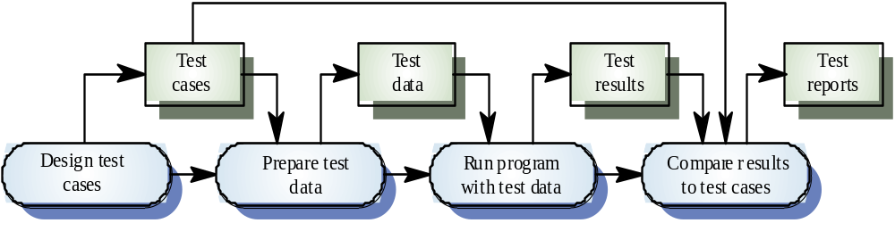
The Defect Testing Process

Slide 25
When To Stop Testing ?
Difficult to determine.
Many modern software applications are so complex, and run in such an interdependent environment, that complete testing can never be done.
Common factors in deciding when to stop are :
→ Deadlines (release deadlines, testing deadlines)
→ Test Cases completed with certain percentage passed
→ Test budget depleted
→ Coverage of code/functionality/requirements reaches a
specified point.
→ Bug rate falls below a certain level

Slide 26
CASE STUDY

